Slide 1

Planning for Flight schedule interruptions

Slide 2
2015 Flights at a Glance
5.8M
Domestic flights
15.9K
Flights per day
12.5%
Flights cancelled or delayed by 30+ min
Notes:
12.4% ~ 1/8

Slide 3
Objective
Can we predict whether a flight will be delayed or cancelled?

Slide 4
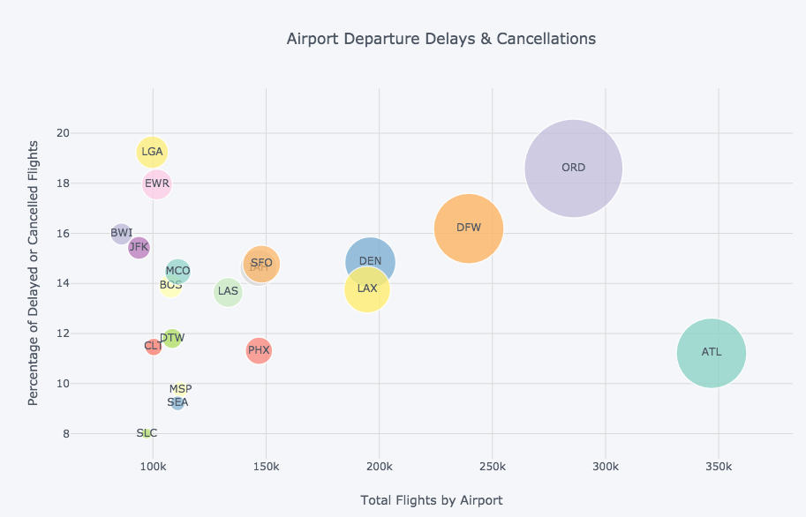
Top 20 Domestic Airports
37.6%
Delays & Cancellations

Slide 5
Data Considered
Flight Info
Origin Airport
Destination Airport
Route Distance
Airline
Timing
Time of Day
Day of Week
Month
Weather Conditions
Precipitation
Snow
Wind
Temperature

Slide 6
Model Selection
Multi-class
300K data point
Imbalanced Classes
Ontime | 82.8%
Delayed | 14.0%
Cancelled | 3.2%
Dependent and varied
features
Random Forest
with Upsampling

Slide 7
Model Results

Slide 8
Model Test Results - Examples
Flight A
Flight B
Cancelled
Delayed
Tuesday, Jan 27 in the morning
American Airlines
From LGA to ORD
Weather Conditions:
Snow: 5 inches
Precipitation: 0.25 inches
Avg Wind Speed: 16.55 mph
Temperature: 24 F
Heavy Fog
Saturday, Jan 3 - early evening
Jetblue
From EWR to MCO
Weather Conditions:
Snow: 0.6 inches
Precipitation: 0.79
Avg Wind Speed: 6.93 mph
Temperature: 34F
Prediction Model
Cancelled | Delayed | Ontime
100% | 0 | 0
Prediction Model
Cancelled | Delayed | Ontime
14% | 62% | 24%

Slide 9
Model Test Results - Limitations
Flight C
Cancelled
Wednesday, July 1 in the morning
American Airlines
From LGA to DCA
Weather Conditions:
Precipitation: 0.35 inches
Avg Wind Speed: 10.51 mph
Temperature: 76 F
Prediction Model
Cancelled | Delayed | Ontime
36% | 23% | 41%
Airline | AA | AA | B6
Day | Tues | Wed | Sun
Month | Jan | Jul | Mar
Time | AM | AM | Early PM
Origin | LGA | LGA | JFK
Dest | ORD | DCA | PWM
Dist | 733 | 214 | 273
Snow | 5 | 0 | 0
Rain | 0.25 | 0.35 | 0
Wind | 16.55 | 10.51 | 20.13
Temp | 24 | 76 | 45
Heavy Fog | TRUE | FALSE | FALSE
Prob (cancelled) | 100% | 36% | 56%
Prob (delayed) | 0 | 23% | 31%
Prob (ontime) | 0 | 41% | 13%
Airline | Day | Month | Time | Origin | Dest | Dist | Snow | Rain | Wind | Temp | Heavy Fog | Prob (cancelled) | Prob (delayed) | Prob (ontime
AA | Tues | Jan | AM | LGA | ORD | 733 | 5.0 | 0.25 | 16.55 | 24 | True | 100% | 0 | 0
AA | Wed | Jul | AM | LGA | DCA | 214 | 0.0 | 0.35 | 10.51 | 76 | False | 36% | 23% | 41%
B6 | Sun | Mar | Early PM | JFK | PWM | 273 | 0.0 | 0.00 | 20.13 | 45 | False | 56% | 31% | 13%

Slide 10
Conclusion
Data Summary
Model Performance
Next Steps
Flight details
Timing/Time of Year
Weather Conditions
Random Forest
Predicts probability of flight cancellations & delays better than chance
The model performs better in situations with more turbulent weather
Obtain data causes of airline/air traffic delays to improve the model
Include additional years of data to see if it makes a difference

Slide 11
Questions?

Slide 12
Appendix

Slide 13
Confusion Matrix without Weather Data

Slide 14
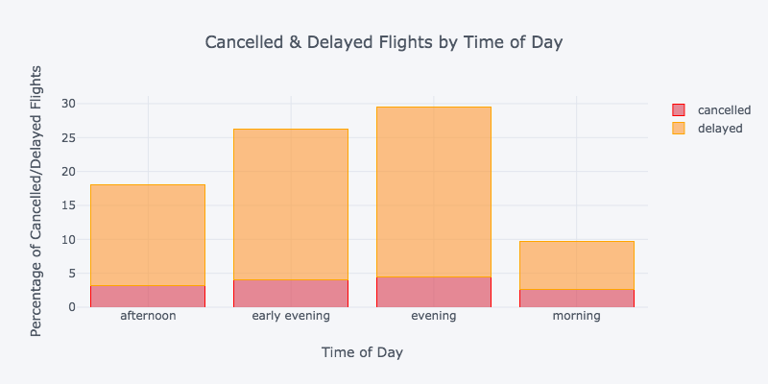
Time of Day

Slide 15
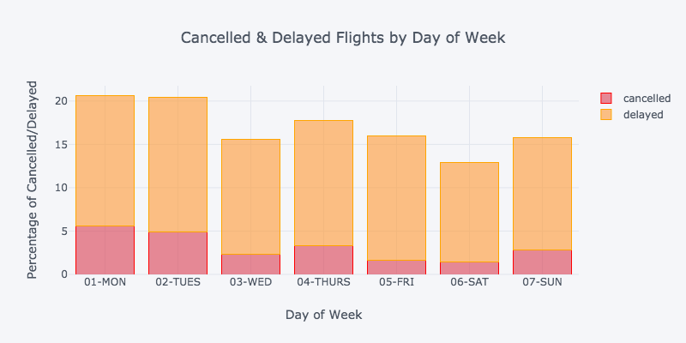
Day of Week

Slide 16
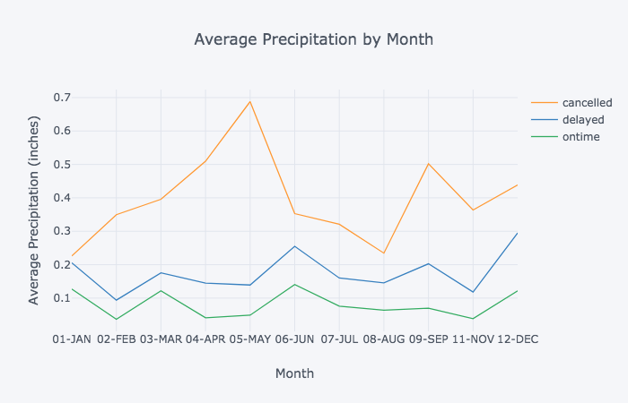
Weather Considerations - Rain

Slide 17
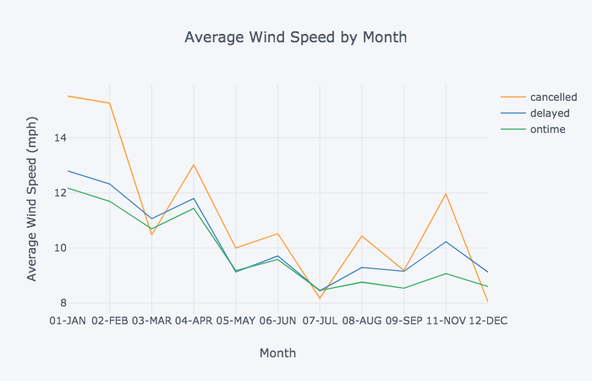
Weather Considerations - Wind

Slide 18
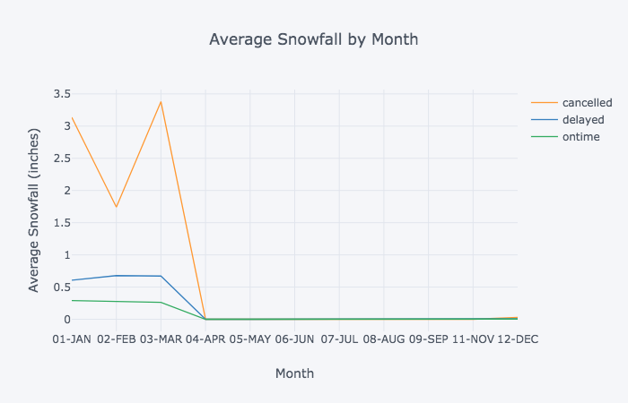
Weather Considerations - Snow

Slide 19
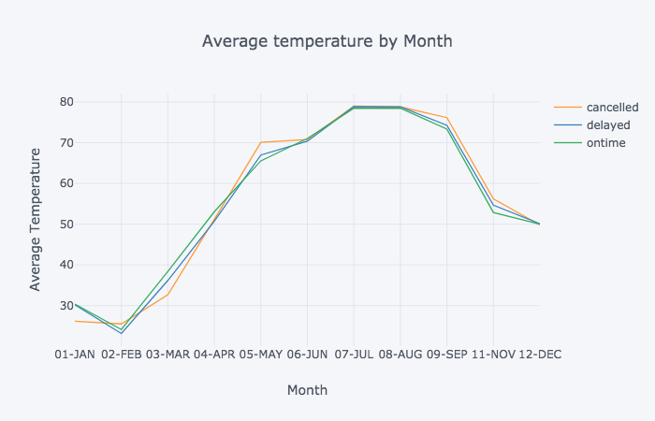
Weather Considerations - Temp

Slide 20
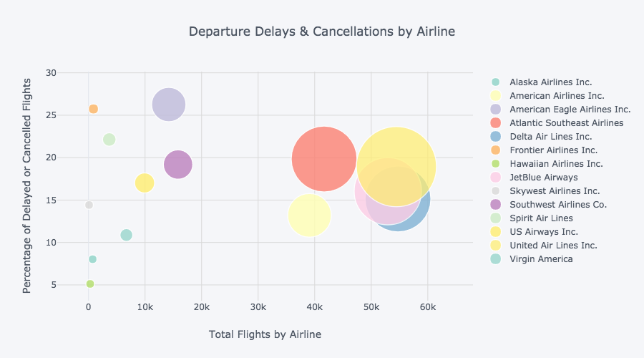
Airlines

Slide 21
Test Flight Cancellations
 | status_x | airline | dayname | monthname | time_of_day | origin_airport | snow | prcp | avg_wind_speed | distance | temp_avg | heavy_fog | Reason for Cancellation | predicted | predicted_prob
3144 | cancelled | EV | 07-SUN | 01-JAN | early evening | EWR | 0.0 | 0.27 | 10.29 | 282 | 44 | True | B | cancelled | [0.62, 0.28, 0.11]
28115 | cancelled | AA | 01-MON | 02-FEB | early evening | JFK | 4.2 | 1.18 | 19.01 | 740 | 32 | True | B | cancelled | [0.85, 0.14, 0.01]
55398 | cancelled | EV | 04-THURS | 03-MAR | morning | LGA | 8.1 | 0.60 | 12.08 | 419 | 33 | True | A | cancelled | [0.97, 0.01, 0.01]
22746 | cancelled | AA | 02-TUES | 01-JAN | morning | LGA | 5.0 | 0.25 | 16.55 | 733 | 24 | True | B | cancelled | [1.0, 0.0, 0.0]
22387 | cancelled | US | 02-TUES | 01-JAN | morning | EWR | 3.5 | 0.23 | 17.22 | 529 | 25 | False | B | cancelled | [0.99, 0.01, 0.01]
162769 | cancelled | AA | 03-WED | 07-JUL | morning | LGA | 0.0 | 0.35 | 10.51 | 214 | 76 | False | A | ontime | [0.36, 0.23, 0.41]
64660 | cancelled | B6 | 07-SUN | 03-MAR | afternoon | JFK | 0.0 | 0.00 | 20.13 | 273 | 45 | False | C | cancelled | [0.56, 0.31, 0.13]
4757 | cancelled | MQ | 02-TUES | 01-JAN | afternoon | LGA | 1.0 | 0.05 | 8.28 | 431 | 21 | False | B | cancelled | [0.55, 0.37, 0.08]

Slide 22
Model Results – Delayed Flights
 | status_x | airline | dayname | monthname | time_of_day | origin_airport | snow | prcp | avg_wind_speed | distance | temp_avg | heavy_fog |  | predicted | predicted_prob
241958 | delayed | AA | 01-MON | 09-SEP | morning | LGA | 0.0 | 0.00 | 6.93 | 733 | 69 | False | AIRLINE | ontime | [0.07, 0.17, 0.76]
56836 | delayed | B6 | 05-FRI | 03-MAR | early evening | EWR | 0.0 | 0.00 | 7.61 | 200 | 20 | False | LATE AIRCRAFT | delayed | [0.21, 0.54, 0.25]
178775 | delayed | AA | 06-SAT | 07-JUL | early evening | JFK | 0.0 | 0.02 | 11.41 | 2446 | 76 | False | LATE AIRCRAFT | delayed | [0.09, 0.52, 0.39]
288583 | delayed | EV | 03-WED | 12-DEC | afternoon | EWR | 0.0 | 1.44 | 4.25 | 284 | 55 | True | LATE AIRCRAFT | cancelled | [0.82, 0.15, 0.04]
150707 | delayed | DL | 03-WED | 06-JUN | evening | JFK | 0.0 | 0.00 | 9.62 | 301 | 74 | False | LATE AIRCRAFT | ontime | [0.05, 0.44, 0.5]
2327 | delayed | B6 | 06-SAT | 01-JAN | early evening | EWR | 0.6 | 0.79 | 6.93 | 937 | 34 | False | LATE AIRCRAFT | delayed | [0.14, 0.62, 0.24]

Slide 23
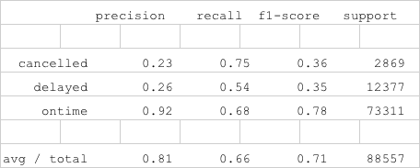
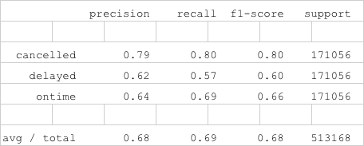
Classification Report
Test Set
Train Set

